Slide 1


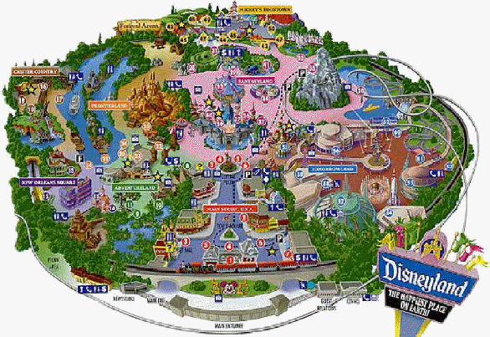
Unit 5
Theme parks

Slide 2
Discussion
Brainstorming:
chat with friends
enjoy the scenery
…
parks
have a picnic
play games
have fun
relax

Slide 3
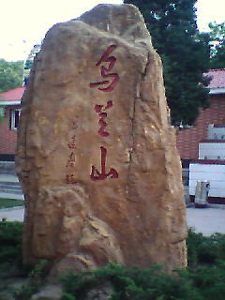
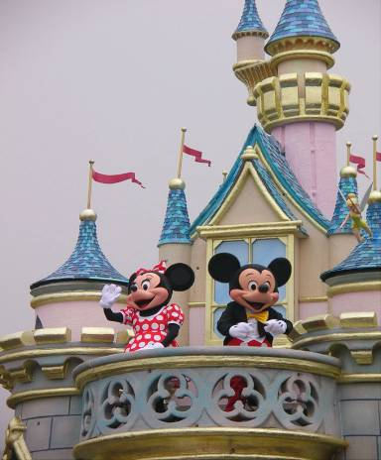
Do you know the differences between
and
a park
a theme park

Slide 4

What is a theme park?
It is a kind of amusement park
which has a certain idea---a certain theme – that the whole park is based on.

Slide 5
What kinds of theme parks do you know?
history theme park
sports theme park
marine or
ocean park
theme
parks
future park
science
theme park
culture theme park

Slide 6

There are various kinds of theme parks in Shenzhen. Would you name some theme parks you know?

Slide 7
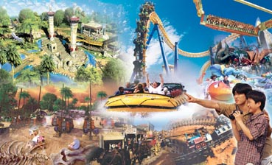
Happy Valley

Slide 8
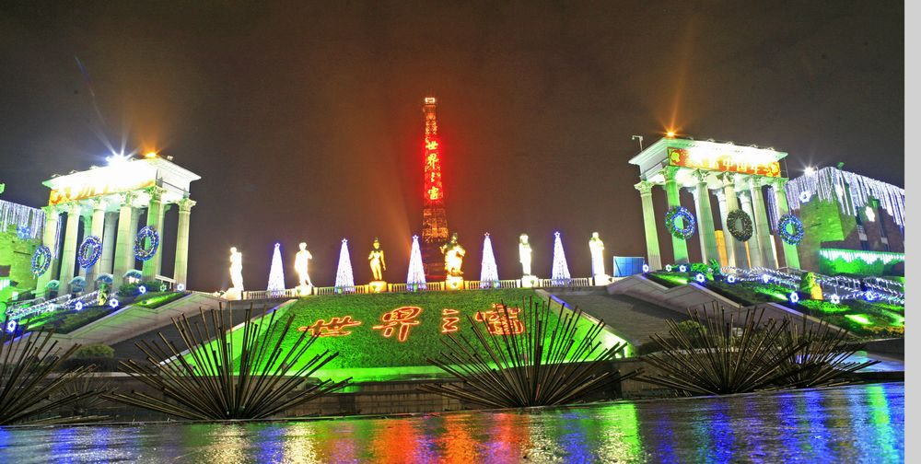
Window of the World

Slide 9
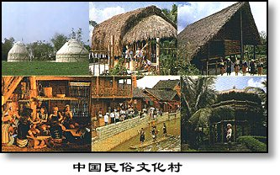
China Folk Culture Village

Slide 10
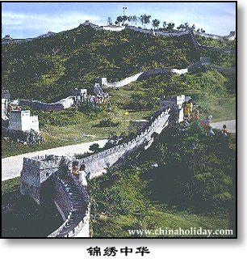
Shenzhen Splendid China

Slide 11
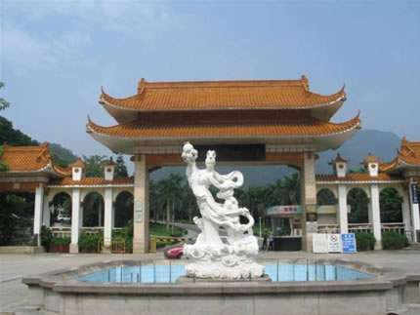
Xiahu Botanical Garden

Slide 12
Discussion
With your partner, discuss what kind of activities we can take in a theme park.

Slide 13
These theme parks have a variety of things to see and do.
Sports theme park:
Sports to play or watch; physical exercise and athletic competition.
History theme park:
See how ancestors dressed, worked and lived.
Culture theme park:
See how special groups dress today, what they eat and what the homes look like, cook culture food, take pictures in the special clothing.

Slide 14
Marine or ocean theme park:
See and swim with dolphins and learn about ocean life.
Science theme park:
Take part in experiments.
future park:
Go on imaginary trip to space and experience life in the future.

Slide 15
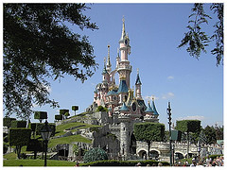
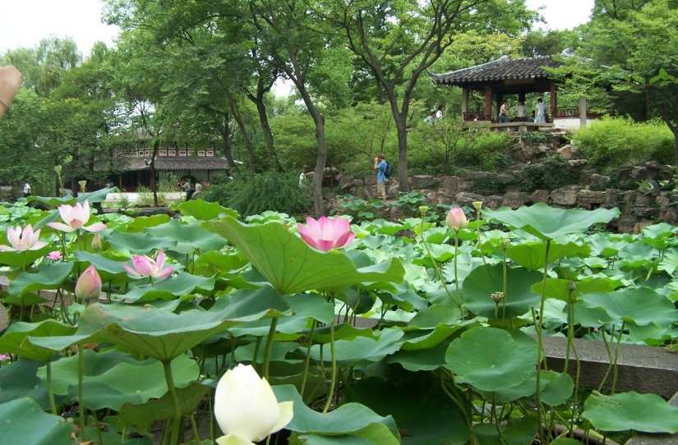
Difference between an ordinary park and a theme park
theme park
knowledge
amusement
A garden in Suzhou
Disneyland
Theme parks combine fun with learning

Slide 16



Skimming
Reading Comprehension I
Answer the question.
What is the meaning of the title “Theme
Parks - Fun and More Than Fun”?
The title means that theme parks are fun to visit, but that they can also be educational and can offer useful information.

Slide 17

Skimming
Reading Comprehension II
Choose the best answer.
What’s the text mainly about?
A. The differences among theme parks.
B. An introduction to three theme parks.
C. Theme parks are more than fun.
D. Disneyland is more popular than other
theme parks.

Slide 18
Skimming
Reading Comprehension III
Find the topic sentence of each paragraph and.
Para. 1
There are various kinds of theme parks
Para. 2
If you want to have fun and more
than fun, come to Disneyland.
Para. 3
Come to Dollywood to have fun
learning all about America’s historical
southeastern culture.
Para. 4
To enter a world of fantasy about
ancient England, come to Camelot Park.

Slide 19
Scanning
Reading Comprehension V
Complete the table below.
Park name | Theme | Example of Activities
Disneyland
Dollywood
Camelot

Slide 20
Park name | Theme | Example of Activities
Disneyland
fairy tale
stories
travel through space, visit a pirate ship, meet fairy tale or Disney cartoon character, ride a swinging ship, go on a free-fall drop

Slide 21
Park name | Theme | Example of Activities
Dolly- wood
listen to American country music,
see traditional craftsmen and their work,
try some traditional candy,
ride on an old steam-engine train,
see bald eagles,
ride on Thunderhead and other rides
culture of
the
south-eastern
USA

Slide 22
Park name | Theme | Example of Activities
Camelot
ancient English history and stories
watch magic show,
see fighting with swords or on horseback,
visit farm area,
learn about farms in ancient England

Slide 23

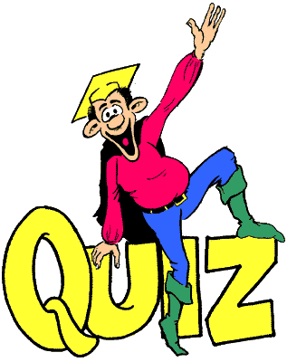
Individual activity

Slide 24
Retell the text by filling in the following blanks.
There are 1___ ____(vary) kinds of theme parks with a different park for almost everything: food, culture, science, cartoons, movies or history. Some parks are famous for having the biggest or longest roller coasters, 2_________ for showing the famous sights and sounds of a culture. The theme park you are _________(probable) most familiar with is Disneyland, which can make your dreams come true. 4_________ you wander around the fantasy amusement park, you may see Snow White or Mickey Mouse. With so many 5_________(attract), no wonder tourism is increasing 6________ there is a Disneyland. Dollywood, in the beautiful Smoky

Slide 25
Mountains in the southeastern USA, is one of the most unique theme parks in the world, where the main attraction is 7____ ___ culture. If you want to learn all about American historical southeastern culture, you can come to Dollywood 8____ ___ (have) fun. If you want to experience the ancient days, then England’s Camelot Park is the place for you, where every area of the park is 9_________(model) after life in the days of King Arthur and the Knights of the Round Table. In a word, it’s 10________ world of fantasy about ancient England.
1.various 2. others 3. probably
4. As 5. attractions 6. wherever
7. its 8. to have 9. modelled
10. a

Slide 26
V-ing (令人…的）&V-ed （感到…的）
satisfy
excite
confuse
relax
inspire
tire

Slide 27
The _______(surprise) look on her face suggested that she hadn’t known it before.
To tell you the _____(true), I think it ______(embarrass)to speak English before a machine.
It’s ______(true) an honor to take part in the English speaking contest.

Slide 28
Remain 的用法
Please remain______(seat) until the plane has come to a complete stop
It remains _________(see)whether you are right.
With many major economic problems____(remain)to be solved, there is no point predicting the growth rate of this year now.
The guests had their meal and left, with nothing ______(remain/leave) on the table.
Nothing ______(remain/leave) after the great fire.

Slide 29
I spend little time practicing English though I am always the first in the ___5___(write) exam.
To my delight, when ___8__(give) the test paper today, I found the questions not so difficult as ____9____(expect)

Slide 30

高考实战
(2010四川) A great number of students ___________ said they were forced to practise the piano.
A. to question B. to be questioned
C. questioned D. questioning

Slide 31
(2009·全国Ⅰ)
Now that we’ve discussed our problem, are people happy with the decisions ______？
A. taking B. take
C. taken D. to take

Slide 32
高考实战
【2011福建卷】Tsinghua University, ________ in 1911, is home to a great number of outstanding figures.
A. found B. founding
C. founded D. to be founded

Slide 33
高考实战
(2010北京)I’m calling to enquire about the position____________ in yesterday’s China Daily.
A. advertised B. to be advertised
C. advertising D. having advertised

Slide 34
高考实战
(2011·江苏) Recently a survey ________ prices of the same goods in two different supermarkets has caused heated debate among citizens.
A．compared B．comparing
C．compares D．being compared

Slide 35
高考实战
(2008湖南)The trees ______ in the storm have been moved off the road.
A．being blown down
blown down
blowing down
D. to blow down

Slide 36
(2009·福建)
______ not to miss the flight at 15：20, the manager set out for the airport in a hurry.
A. Reminding B. Reminded
C. To remind D. Having reminded

Slide 37
(2009·重庆)
Michael’s new house is like a huge palace, ______ with his old one.
A. comparing B. compares
C. to compare D. compared

Slide 38
(2009·天津)
______ by the advances in technology, many farmers have set up wind farms on their land.
A. Being encouraged B. Encouraging
C. Encouraged D.Having encouraged

Slide 39
(2009·龙岩毕业班质检)
Realizing I would be late, I quickly dressed my son and, ______ my bag, went to work.
A. carried B. having carried
C. to carry D. carrying

Slide 40
(2009·福建)
In April, 2009, President Hu inspected the warships in Qingdao, ______ the 60th anniversary of the founding of the PLA Navy.
A. marking B. marked
C. having marked D. being marked

Slide 41
(2009·金丽衢十二校联考)
______ by his grandparents in the countryside, he isn’t accustomed to ______ in the city.
A. Having brought up; live
B. Grown up; living
C. Growing up; live
D. Brought up; living

Slide 42
［2011·江西卷］
On receiving a phone call from his wife ________ she had a fall, Mr. Gordon immediately rushed home from office.
A．says B．said
C．saying D．to say

Slide 43
(2011·上海)
________in 1955, Disneyland in California is regarded by many as the original fun park.
A. Opened B. Having opened
C. Opening D. Being opened

Slide 44
(2011·天津)
________into English, the sentence was found to have an entirely different word order.
A. Translating B. Translated
C. To translate D. Having translated

Slide 45
The flowers _______ sweet in the botanic garden attract the visitors to the beauty of nature.
A. to smell B. smelling
C. smelt D. to be smelt

Slide 46
Don’t use words, expressions, or phrases __________ only to people with specific knowledge.
A. being known B. having been known
C. to be known D. known

Slide 47
(2009·北京)
______ twice, the postman refused to deliver our letters unless we chained our dog.
A. Being bitten B. Bitten
C. Having bitten D. To be bitten

Slide 48

（10天津12）
It rained heavily in the south，______ serious flooding in several provinces.
A. caused B. having caused
C. causing D. to cause

Slide 49
重点单词讲解
1.various adj.各种不同的；各种各样的
__________v.有差异；变化；改变
__________n.不同种类；变种；变化
_______________________[搭配]多种多样的；种种
vary
variety
a variety of/varieties of

Slide 50
1). Of all the ________ (variety) methods of learning a foreign language, I think this is the best.
2). ________ (variety) of TV programmes are being broadcast on TV at present.
3). Prices vary _____ five yuan ____ ten yuan.
4). The flowers varied ______ color and size.
various
Varieties
from to
in

Slide 51

由于各种原因，我不愿见他。
For various (kinds of )reasons, I prefer not to meet him.
我们的主题公园有各种各样的娱乐设施，你总能找到一款适合你们小孩的。
There are a variety of amusement facilities in our theme park, so you can always find one suitable for your children.
人们对是否中学就把孩子送出国学习有不同看法。
People’s views on whether middle school students
should be sent abroad for study vary from person to
person.

Slide 52

2. be famous for
纽约以其摩天大楼驰名，每年吸引了大量的游客。
Famous for its skyscrapers, New York attracts a large number of tourists every year.
be famous for =be known for
be famous for = be known as
作为…而闻名
以……而闻名

Slide 53
北京， 作为中国首都，正遭受严重的污染。
Beijing, known as the capital of China, is being polluted severely/seriously.

Slide 54

3. whichever& no matter which
______ team wins on Saturday will go through to the national championships. (2006山东)
A. No matter what
B. No matter which
C. Whatever
D. Whichever

Slide 55
1. Sarah hopes to become a friend of ______shares her interests.
anyone B. whomever
C. whoever D. no matter who
2. _____leaves the room last ought to switch off the light.
Anyone B. Who
C. Whoever D. No matter who
3. _____much advice I gave him, he did exactly what he wanted to do.
How B. Whatever
C. However D. What

Slide 56
______ breaks the law is to be punished.
We’ll remember ______ we turned to for help.

Slide 57
4. amuse v. 使发笑；使愉快
These toys will help to keep the baby _______.
To my great___________, his false
beard fell off.
Our visits to the theatre made the holiday more ________.
Everyone was _______ at the story about the dog.
amused
amusement
amusing
amused

Slide 58
5. no wonder 难怪；不足为奇
难怪孩子们很兴奋，这是他们第一次出国。
（It is）No wonder the children are excited---this is the first time they’ve been abroad.
毫无疑问， 中国人民的生活比三十年前的好多了。
There is no doubt that people in china are much better of than they were 30 years ago.

Slide 59
Its 3-D cinemas and giant movie screen provide brand new experience of the earth and beyond.
The amazing, up-to-date information together with many opportunities for hands-on learning make the world come to life in a completely new way for visitors.
For anyone coming from out of town, Futuroscope has many excellent hotels, most of which provide a shuttle service to the park.

Slide 60
高 考 链 接
1. Vincent received training in painting for a couple of years, ______ he found a job in a big factory.
A. after that B. after which
C. during that D. during which
2. People have lots of problems living in the Central Australian desert, ______ getting water is the most serious.
A. of which B. which C. for which D. through which
3. The English play ______ my students acted at the New Year’s party was a great success.
A. for which B. at which C. in which D. on which
4. Last week, Only two people came to look at the house, _______ wanted to buy it.
A. none of them B. both of them
C. neither of whom D. none of whom
B
A
C
C

Slide 61
6. English is a language shared by several diverse cultures, each of____ uses it somewhat differently .（2011浙江）
A. which B. what C. them D. those
7. She showed the visitors around the museum, the construction _____had taken more than three years. （2011江西）
A. for which B. with which
C. of which D. to which
8. Julie was good at German, French and Russian, all of _______ she spoke fluently.
A. who B. whom C. which D. that
（2011湖南）
A
C
C

Slide 62
语 篇 运 用
Football is popular in our school. I’ve been one of the students of achievement _______ I feel much proud. I would like to thank Mr. Zhang, ________________I would never have learned to play football well. He taught me to dribble the ball, ____________________I will always be grateful. It is a basic skill in football. The ways _________ he encouraged me have gradually built my confidence. He is a man _________ I have the highest respect. We may forget what he said yesterday, but we will never forget how he made us feel.
of which
without whom
to whom／for which
in which
for whom

Slide 63
Is this the first time that you ______(fly) to Paris.
It is high time that we _______(take) effective measures to fight against the increasingly serious pollution.
The boy was floating his boat in spite of the bad weather while other people were sheltering in the house.

Slide 64
Only when you look into the truth can you make a conclusion for the cause of the accident.
Only if you put the sun there did the movements of the other planets in the sky makes sense.(Page 13)

Slide 65
Only if & if only
只有我找到了工作才有足够的钱上学。
Only if I get a job will I have enough money to go to school.
只有得到老师的允许，学生才可以这间屋。
Only if a teacher has given permission is a a student allowed to enter this room.
He looks upset. If only he _______(pass) the exam.

Slide 66
By 的用法 （表增减程度）
Tommy defeated Jack _____about 0.5 meter and won the race in the end.
The bullet missed me ______2 inches.
The rope needs to be longer _____two feet.

Slide 67
attend 的用法
If you go out, who will attend to the baby.
I may be late. I have one or two things to attend to.

Slide 68
In summer, ______(expose) to the sun is harmful to your skin.
In summer, _______(expose) to the sun for a long time, you’ll be sunburnt.

Slide 69
Suggest 的用法
All the evidence suggests that he ________(steal) the money.
Her parents suggested that she ______(have) a medical examination.
我建议政府采取有效措施治理拥堵问题。
I suggest that the government (should) take effective measures to deal with the congestion.

Slide 70
______(absorb) in today’s newspaper, he failed to hear the bell.
The novel was so _______(absorb) that she read on without a brak, even forgetting food and sleep.

Slide 71
She is such a kind teacher ______we all like her.
She is such a kind teacher ______we all like.

Slide 72
Blame 的用法
He was so careless that he was ________(blame) for the accident.
________(blame) for making mistakes in speaking English, he looked very upset.

Slide 73
In addtion (to),
Apart from,
Besides

